Slide 1
Welcome to Induction class 2020
BY
Dr M S Gusain
Department of History SGRR(PG) College, Dehradun-248001
Email :historysgrrpgcollege@gmail.com
DR meharbansinghgusain

Slide 4
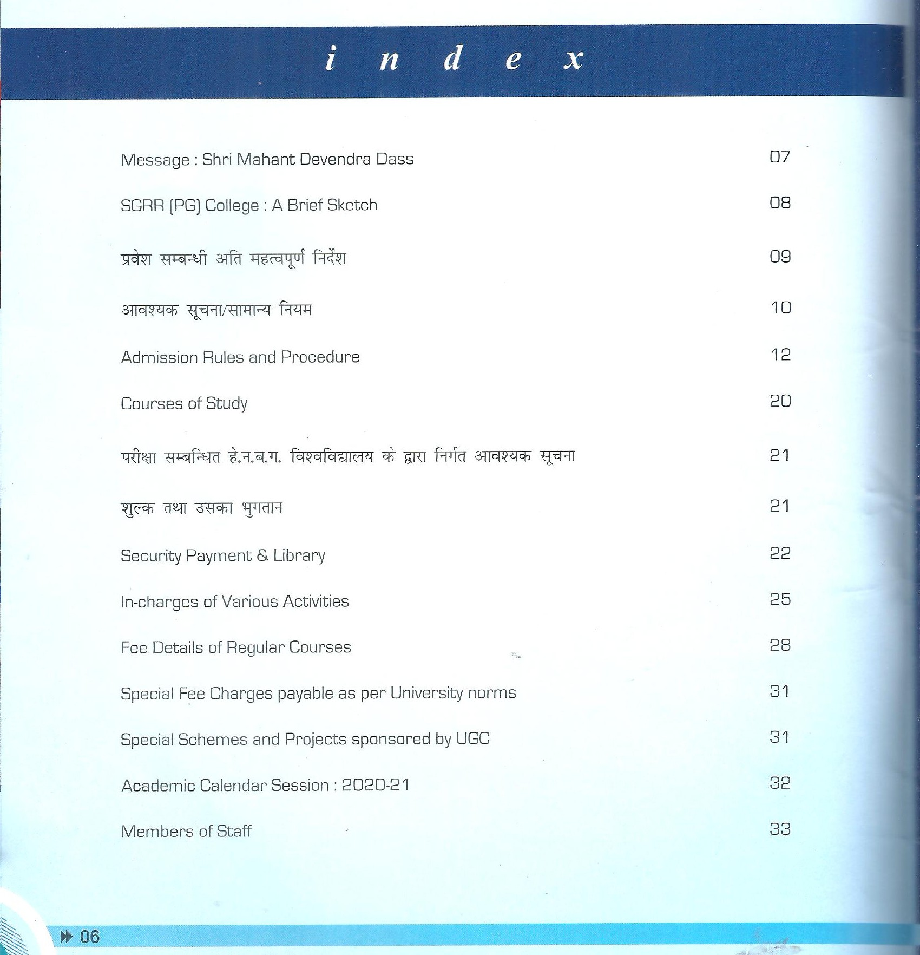
Keep Prospectus of College

Slide 5
DSC -4
AEEC( Skill)-2
DSE-2
GE-2
English Language and EVS (I semester)
English communication and Hindi communication(II semester)

Slide 6
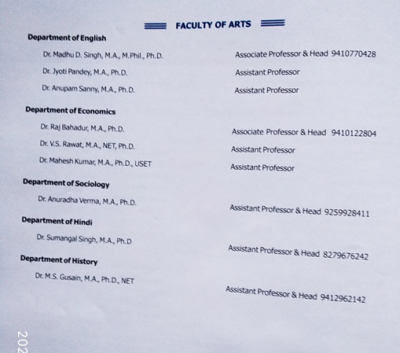
Department of Political Science
Mr Anil, M.A, Persuing Ph.D Assistant Professor (Part Time) 6397728805

Slide 7
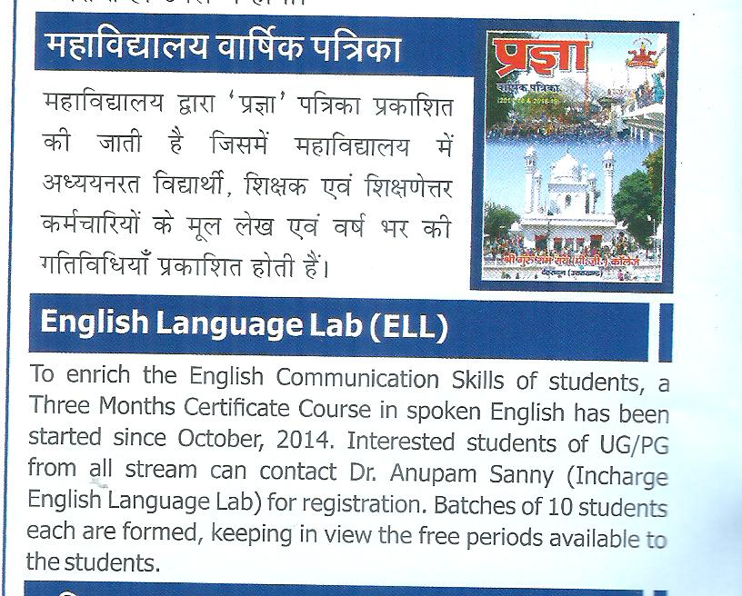
College Magazine
English Language Lab

Slide 8
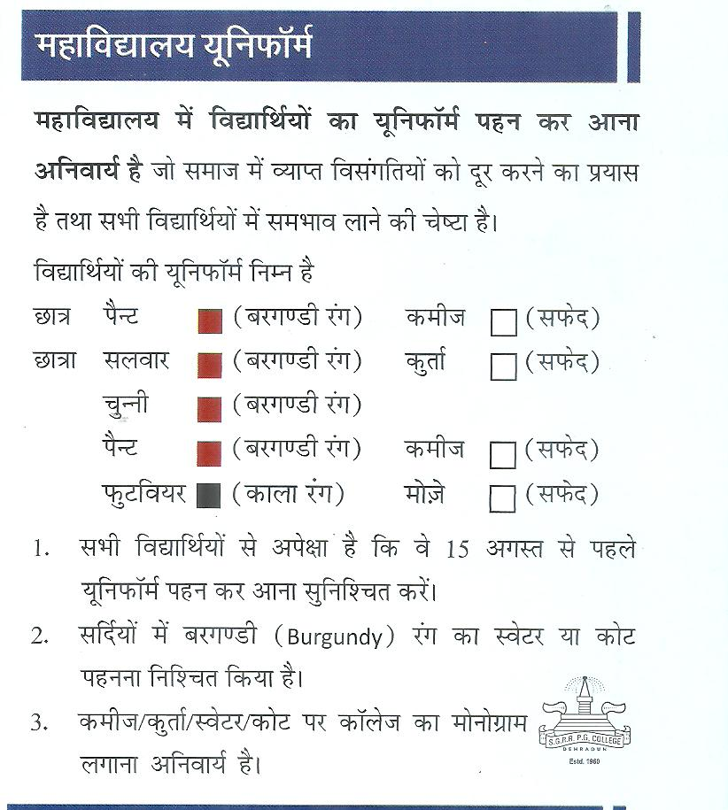
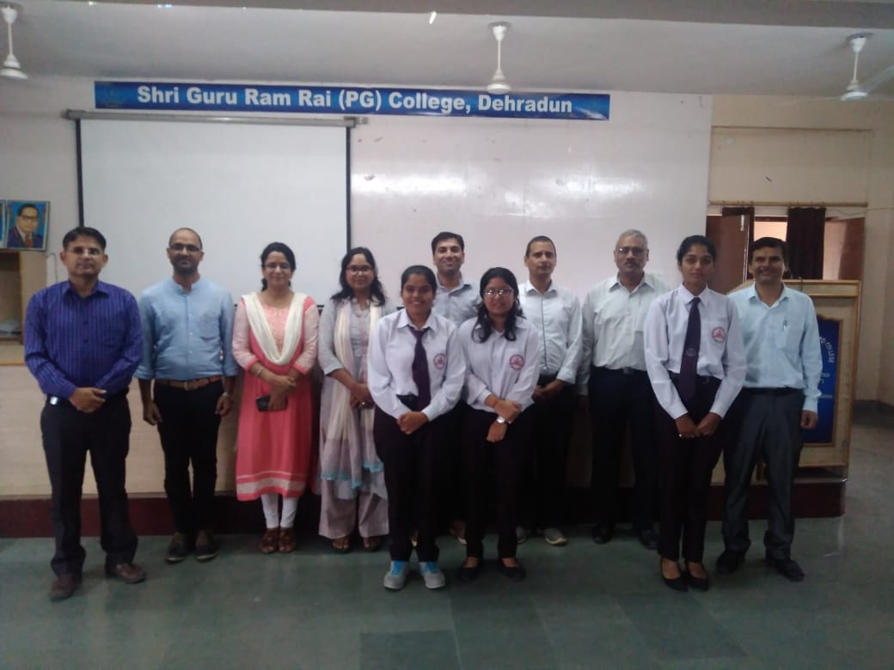
Uniform

Slide 9
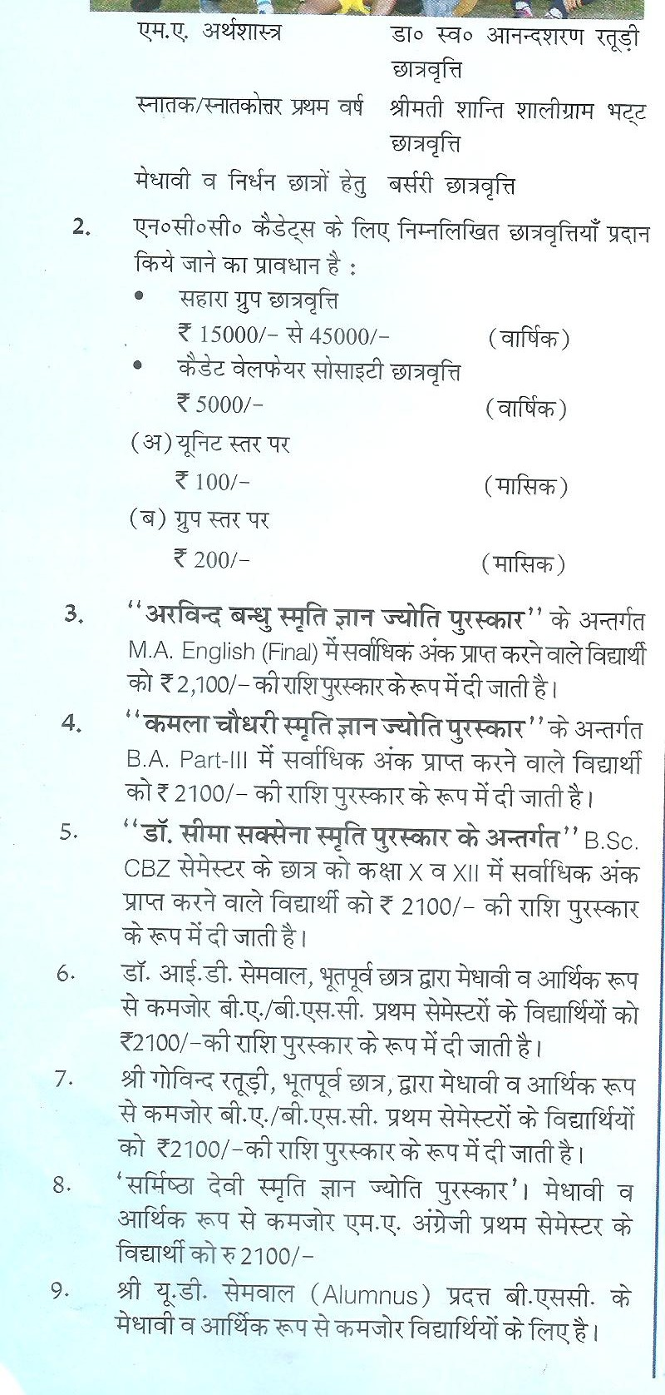
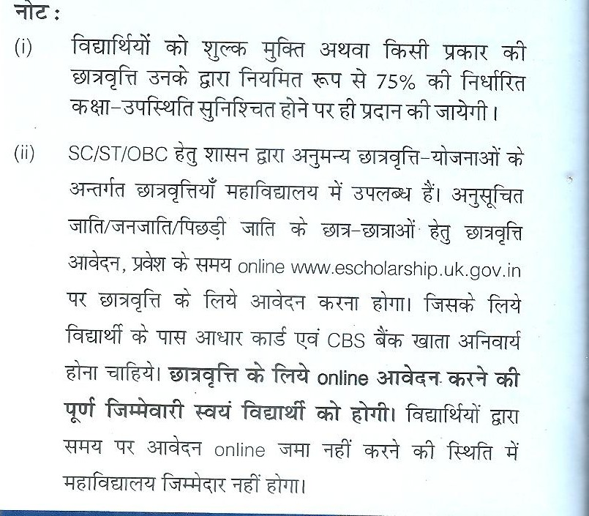
Scholarships in College

Slide 10
Our Library
The college has excellent learning resources in the form of rich library
having 24905 texts books,
2537Reference books
and 6275 E- journals,
40 CD,
15+02 News paper and
36 Hindi, English quality magazines.
Our library also provides the INFLIBNET facility to student and teachers which provides more than 7764088 E-books and journals and many more of N-List and NDL.

Slide 11
Our college try its best to provide
the awareness of conservation of environment,
Plantation drive cleanliness through the seminars, workshop
the cultural week
Beti Bachao Beti Padhao
Awareness of Women Rights in India
Skill Development Fest

Slide 12
We provide-
we keep the periods of mentoring, counselling and guiding in the Time table.
NCC, NSS and Rovers & rangers unit of college is training our students in different skills, values.
The college has registered students in INTERNSHALA for skill development online courses.
WE provide facilities to our research scholars.

Slide 13
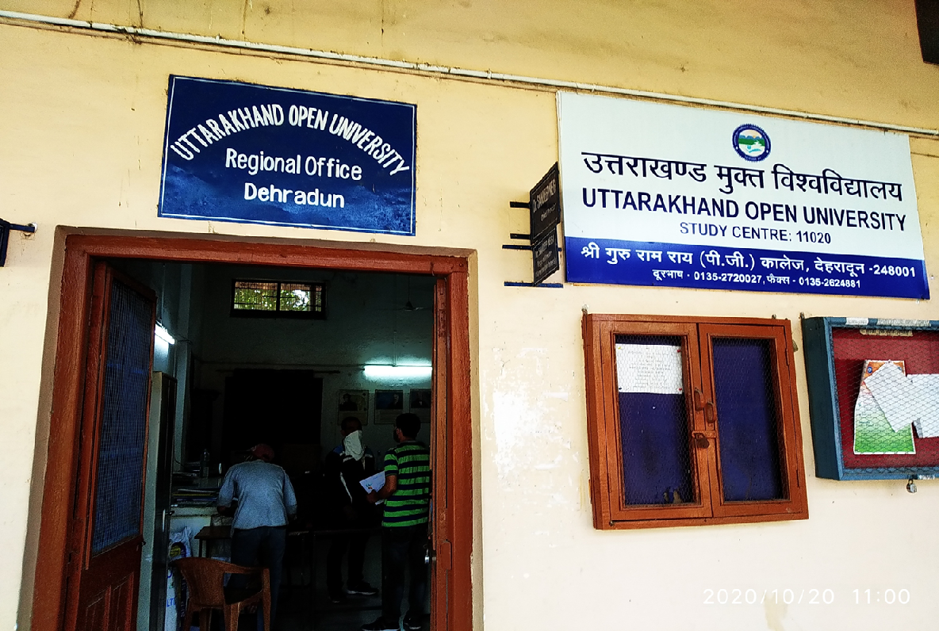
We are Regional Center of UOU
Only one State University in Uttrakhand providing the Distant mode education

Slide 14
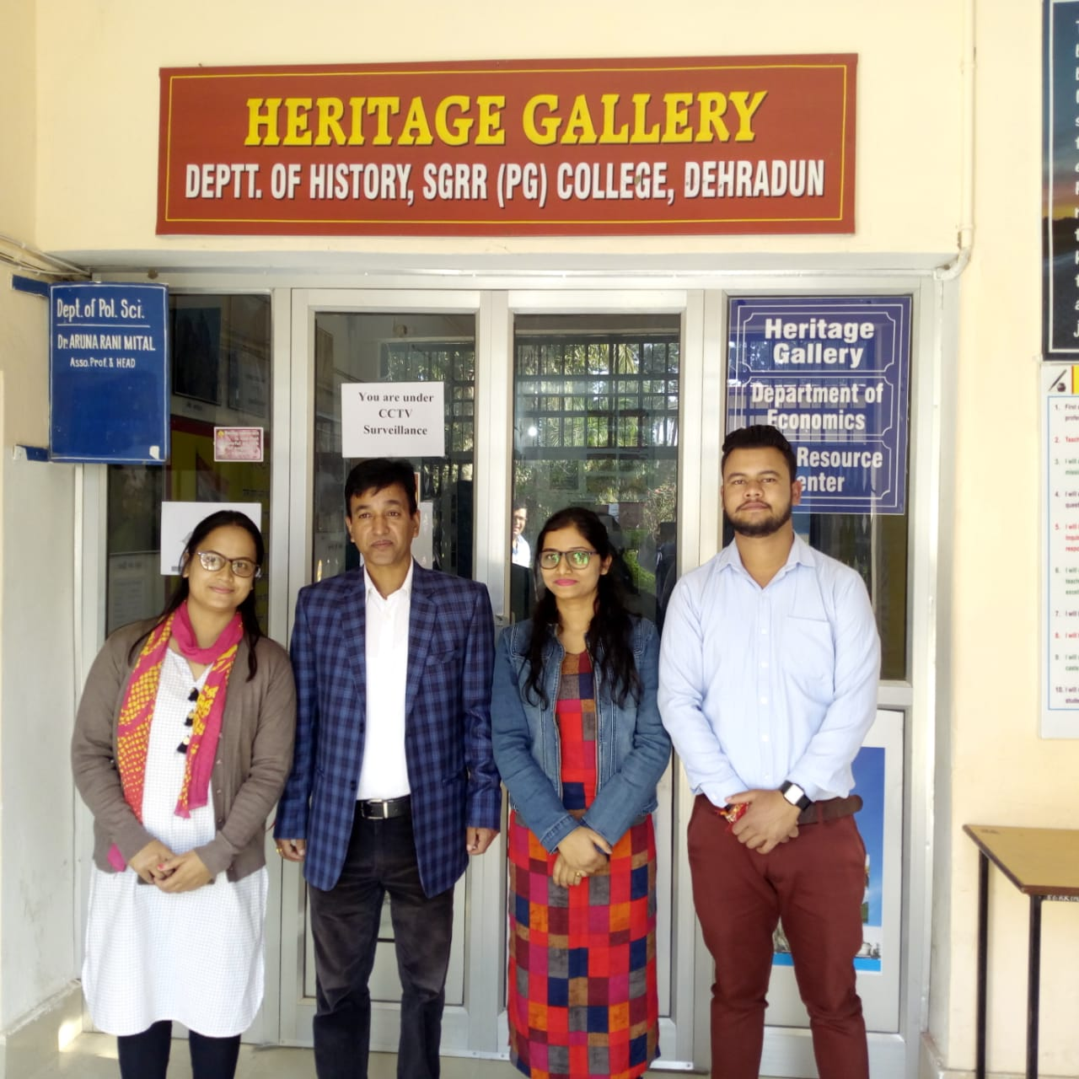
A supportive practice of learning
( useful for subjects like history, sociology, political science and Economics)

Slide 15
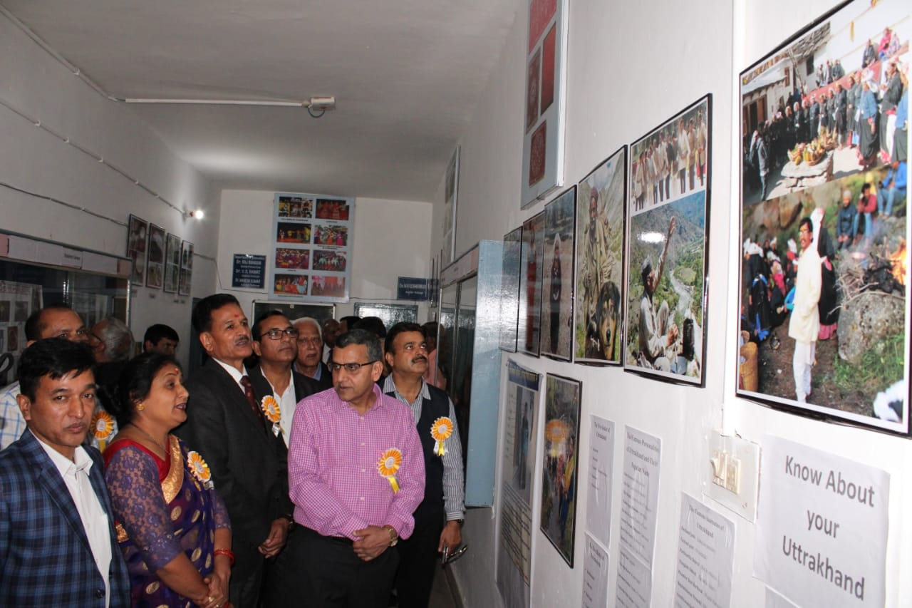
Place for students contribution to The Heritage

Slide 16
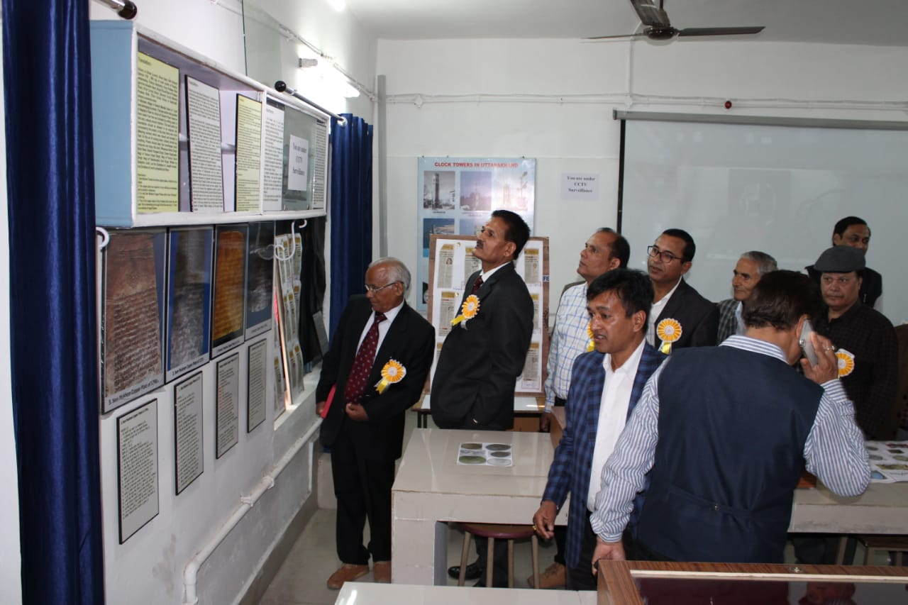
Place of Collection

Slide 17
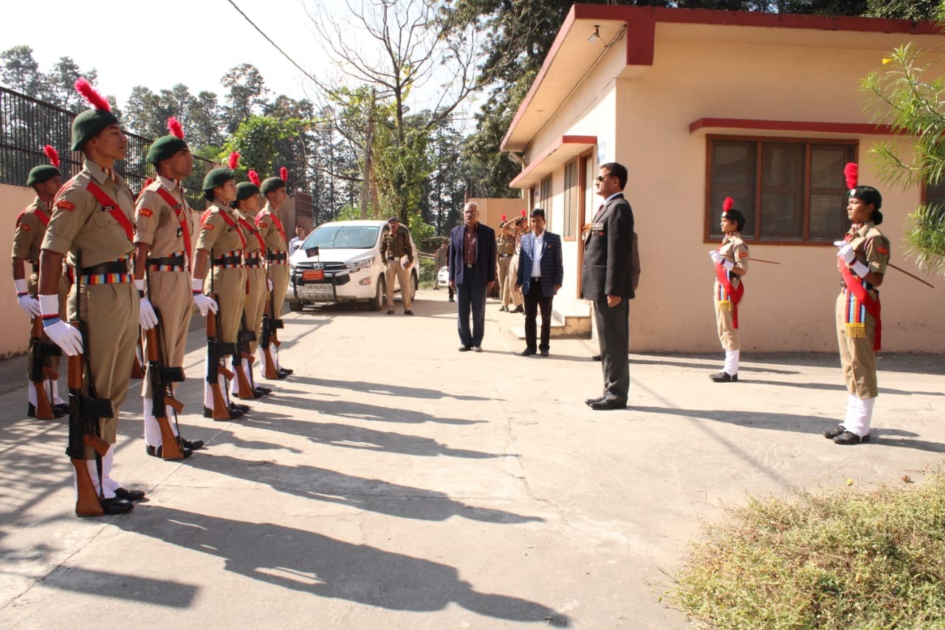
National Cadet Core
Feeling of Pride and
Importance of Discipline

Slide 18
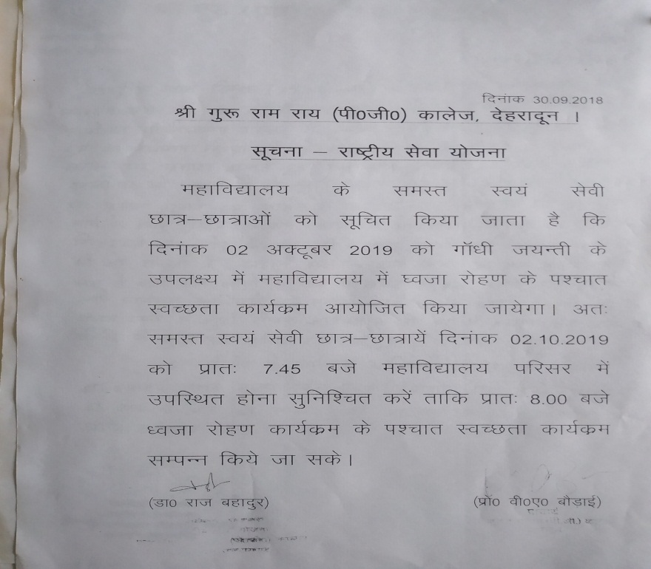
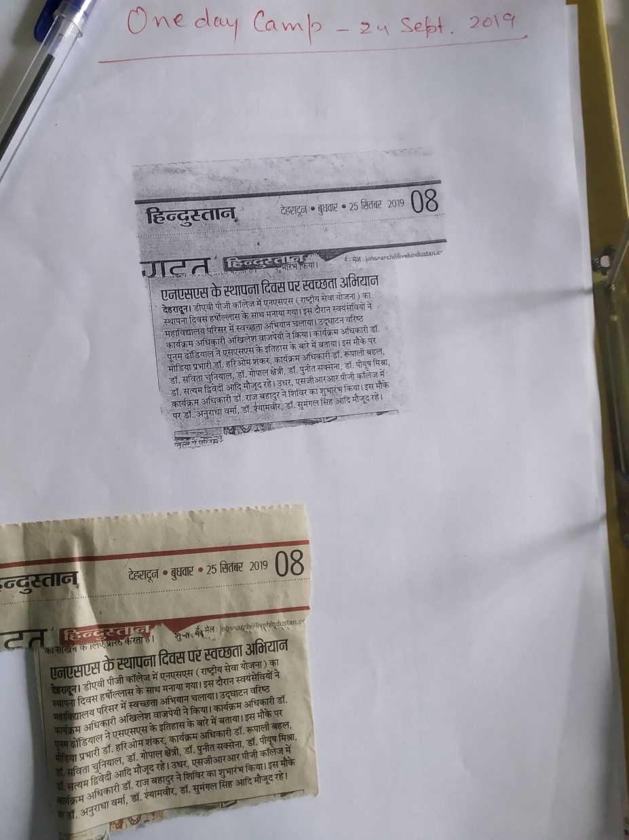
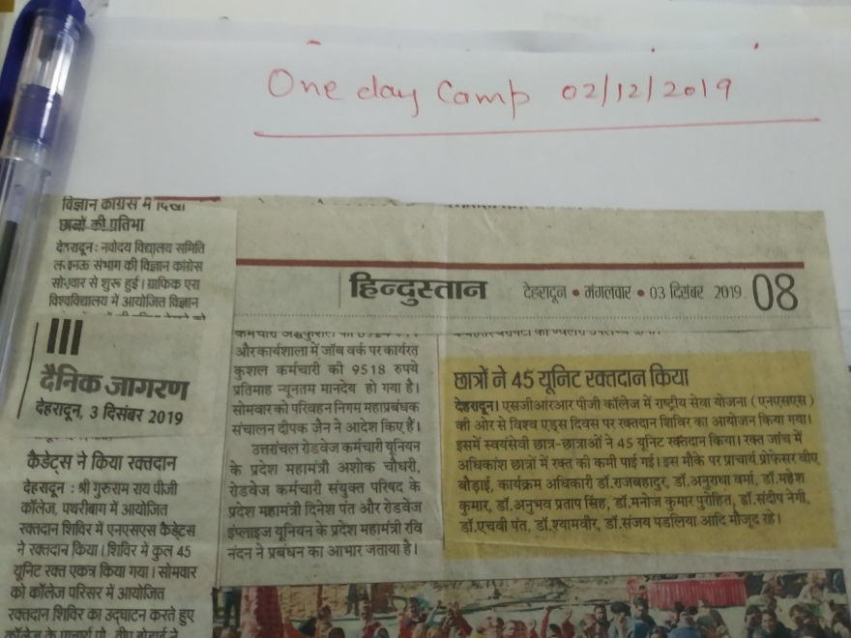
National Service Scheme (NSS)

Slide 19
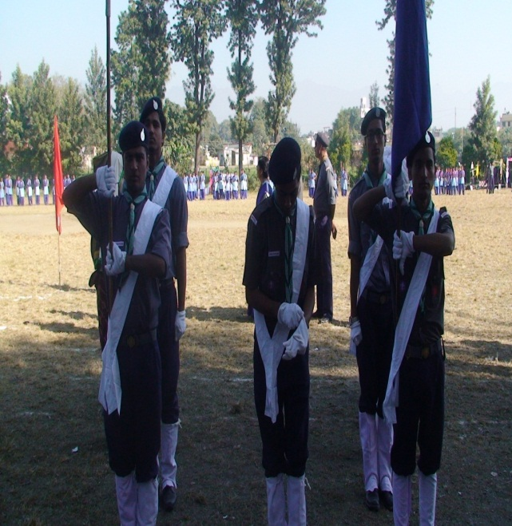
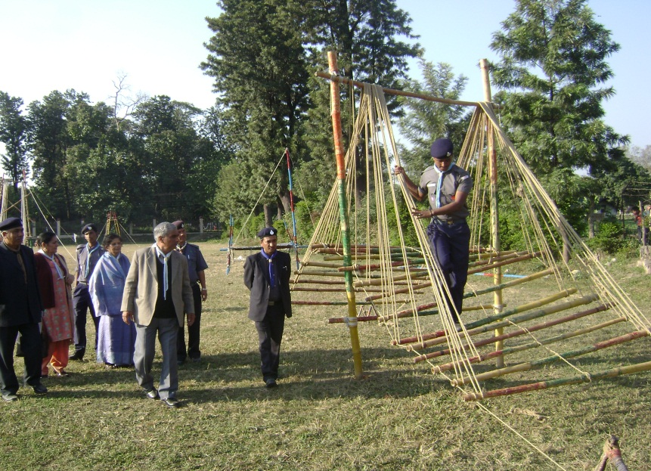
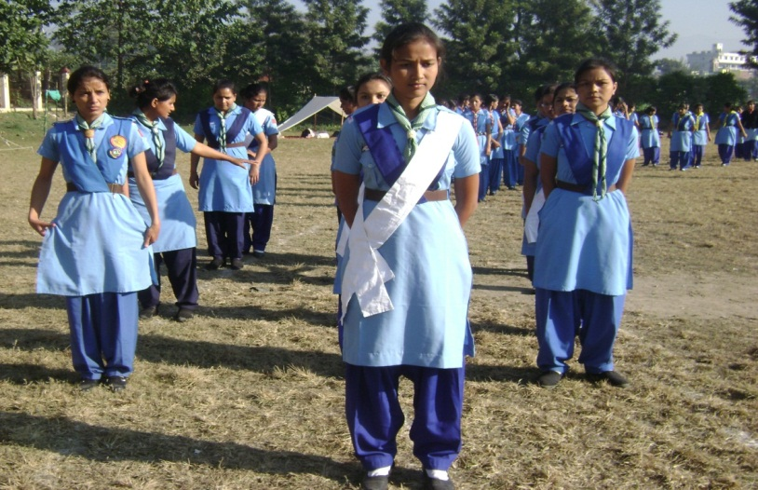
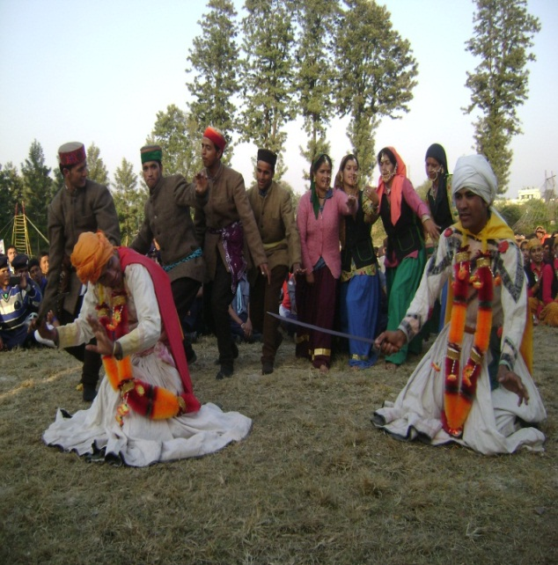
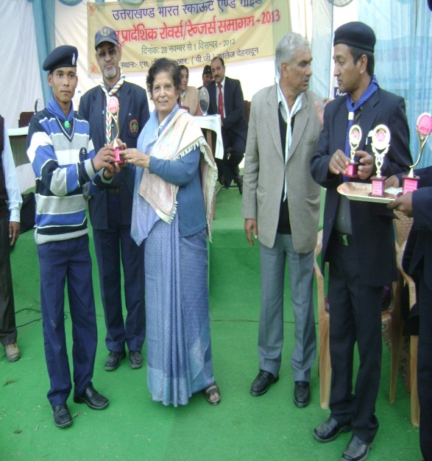
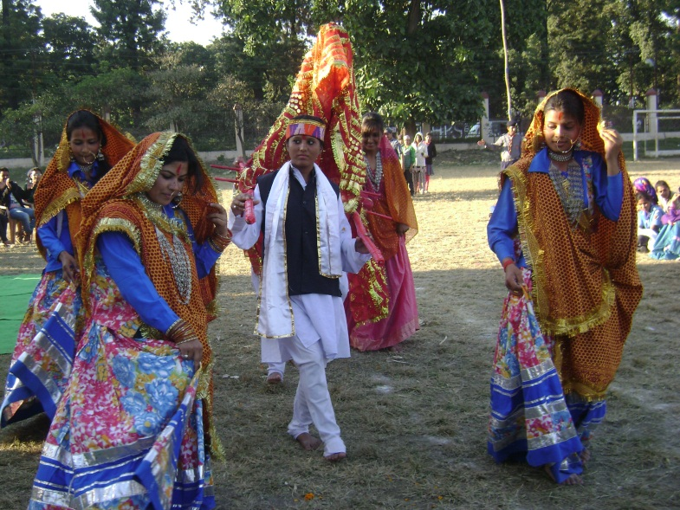
Rovers and Rangers Unit

Slide 20
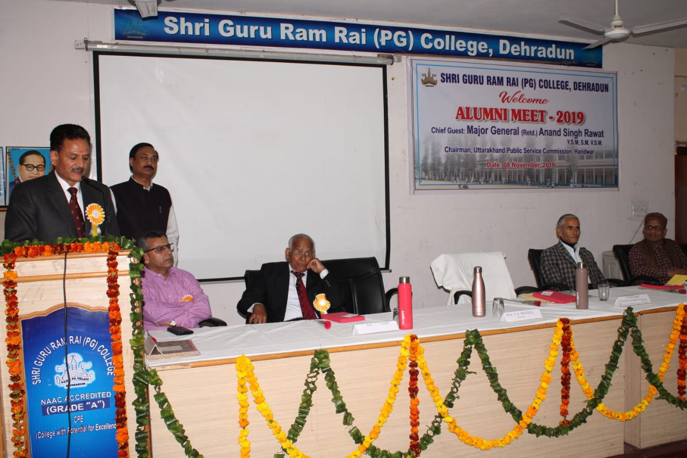
Seminar Hall

Slide 21
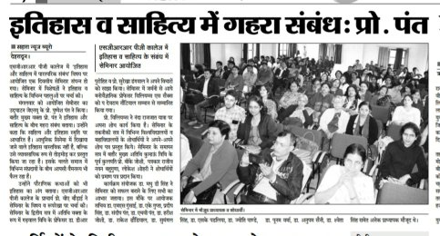
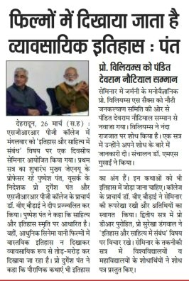
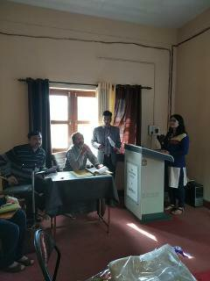
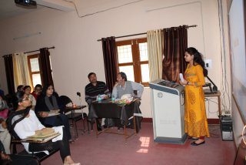
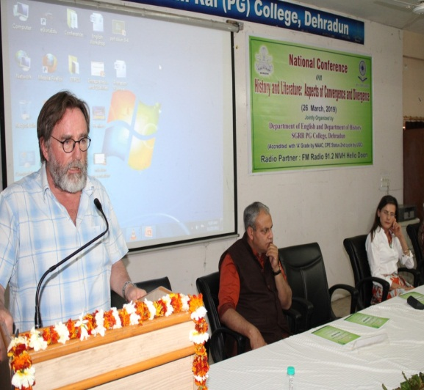
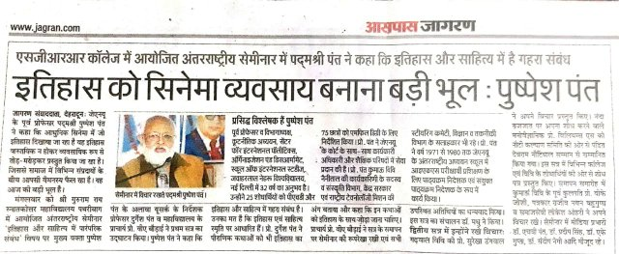
Seminar in College

Slide 22
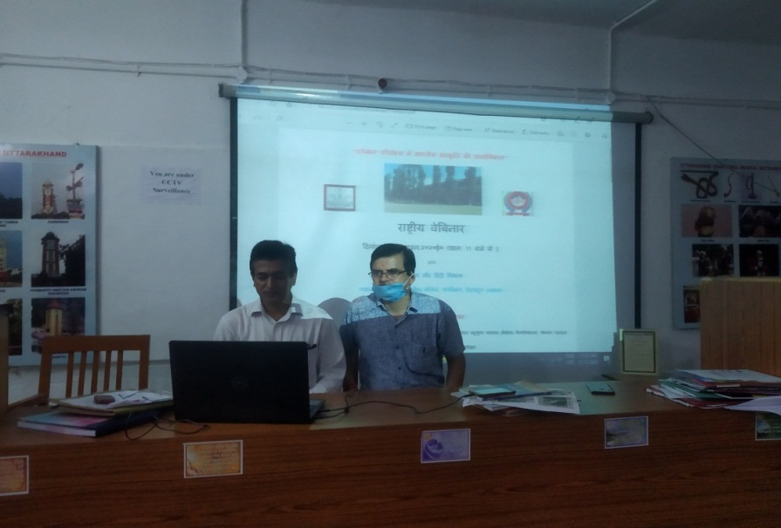
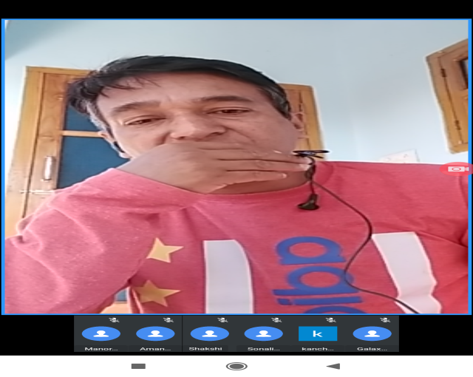
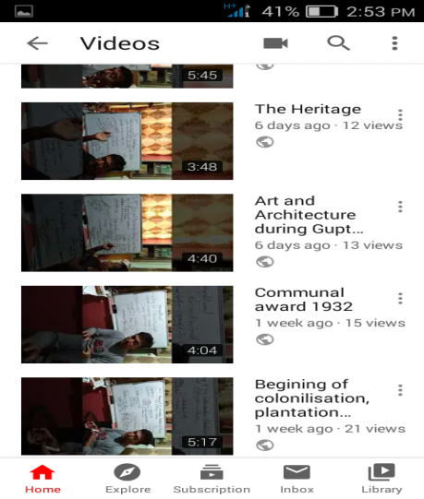
Webinars in College During Covid-19

Slide 23
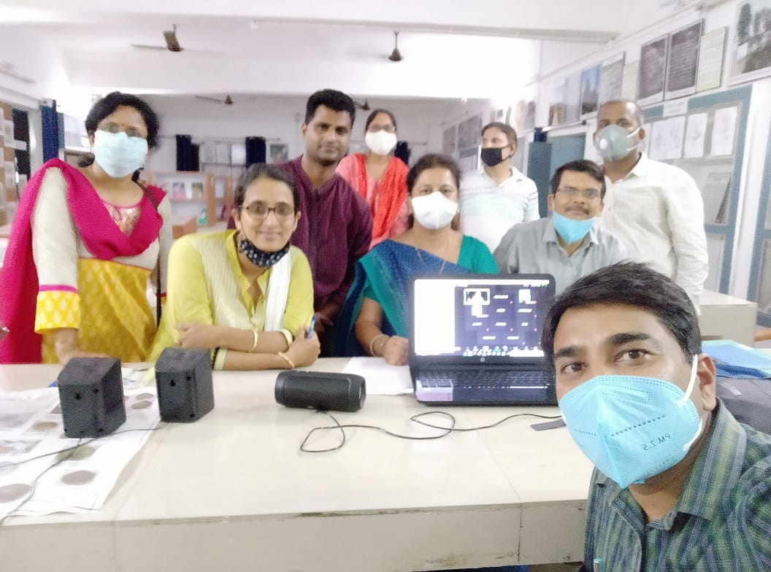
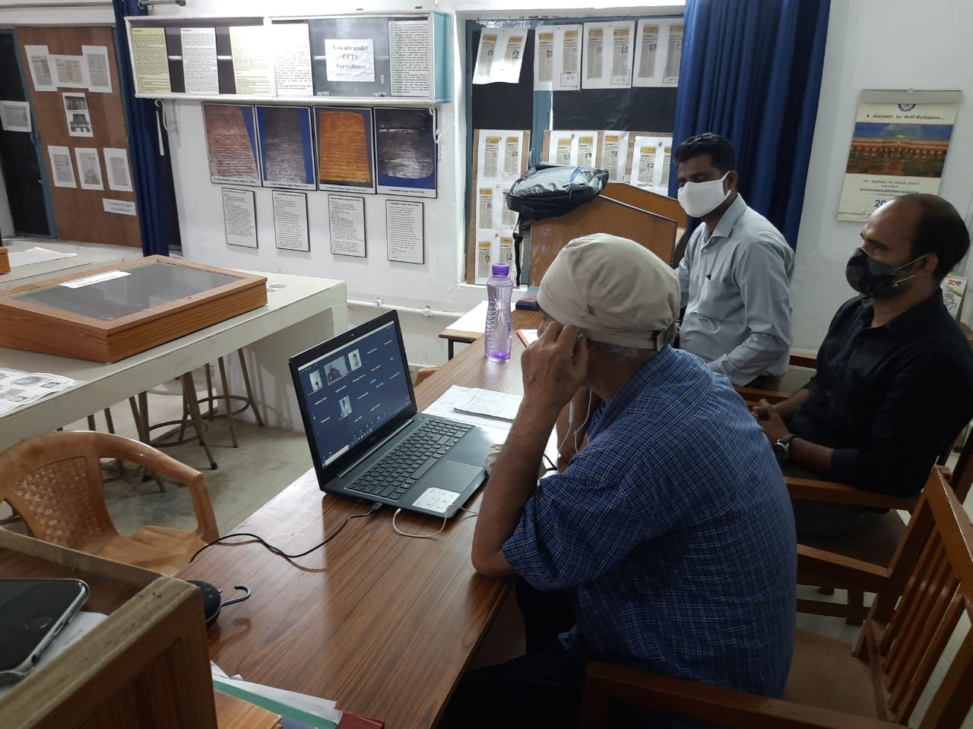
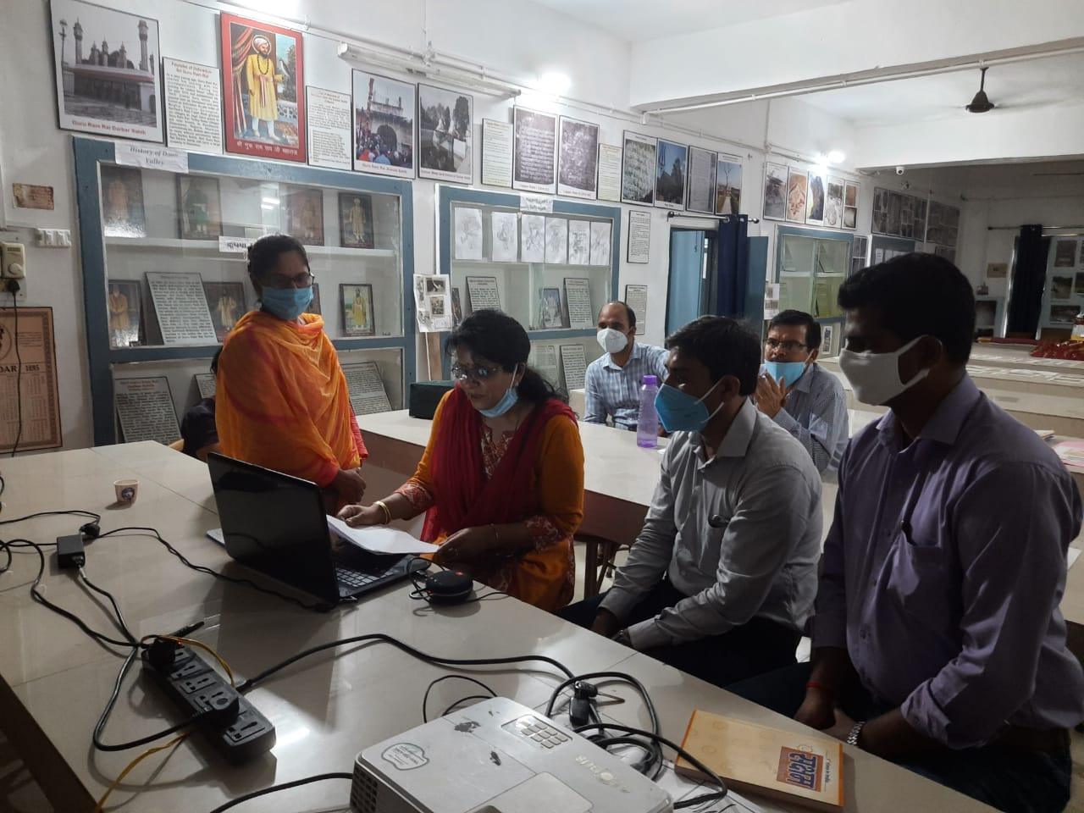
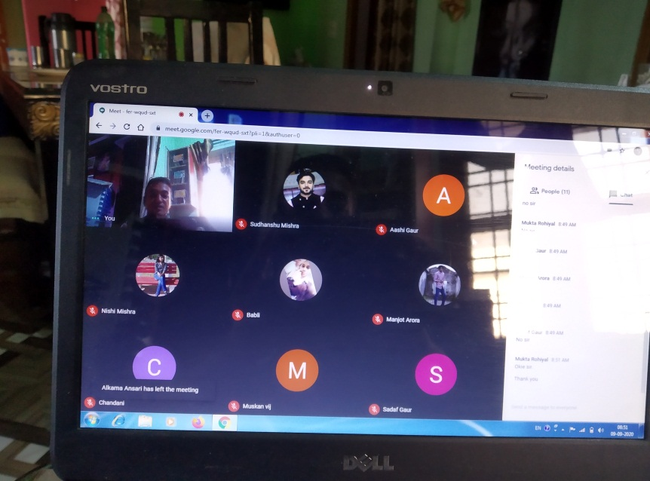
Culture Week during the Covid-19 (Online)

Slide 24
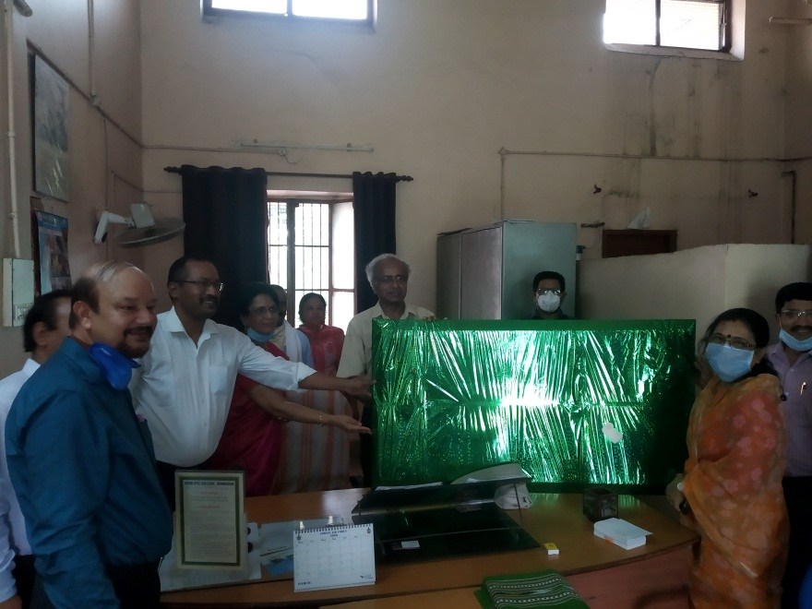
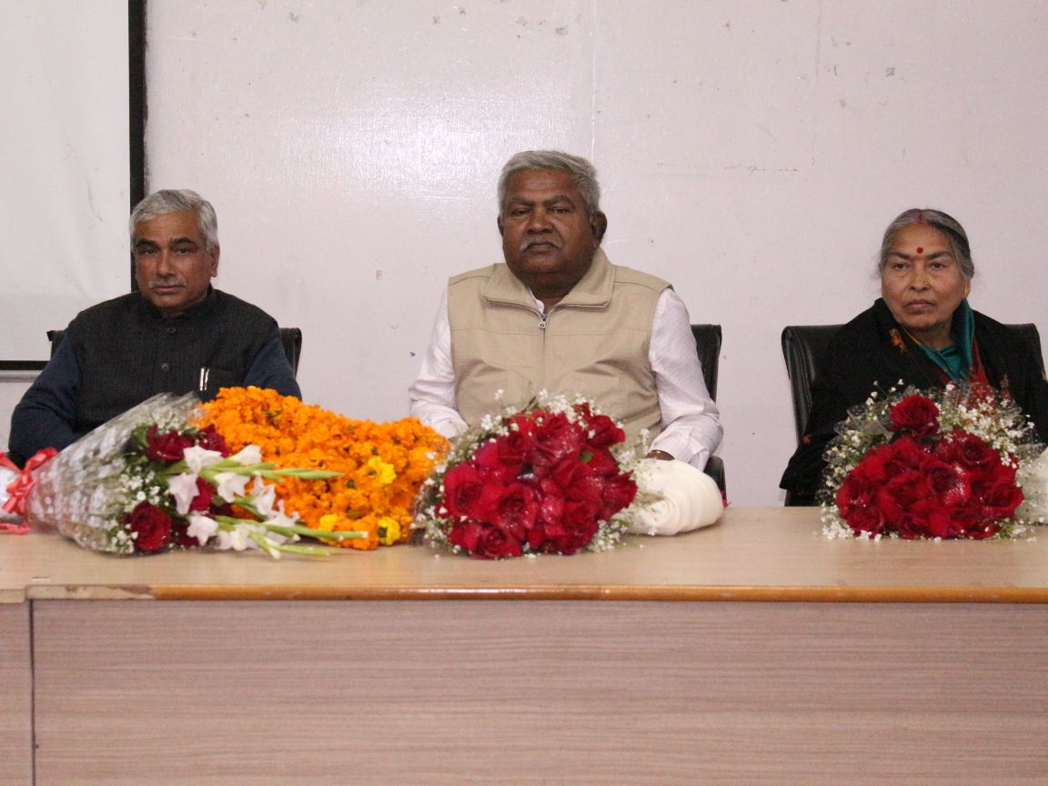
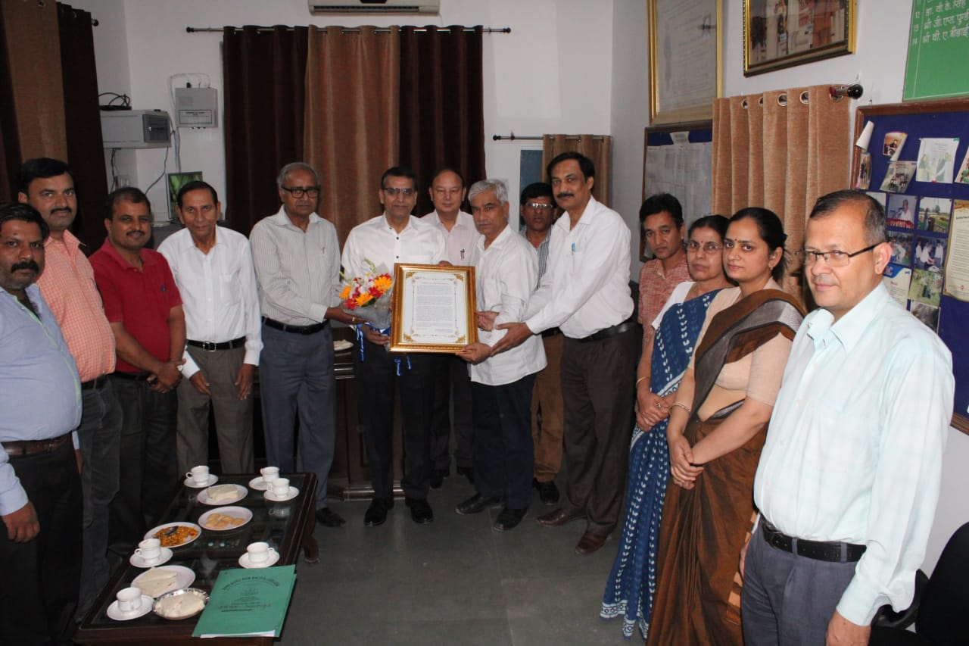
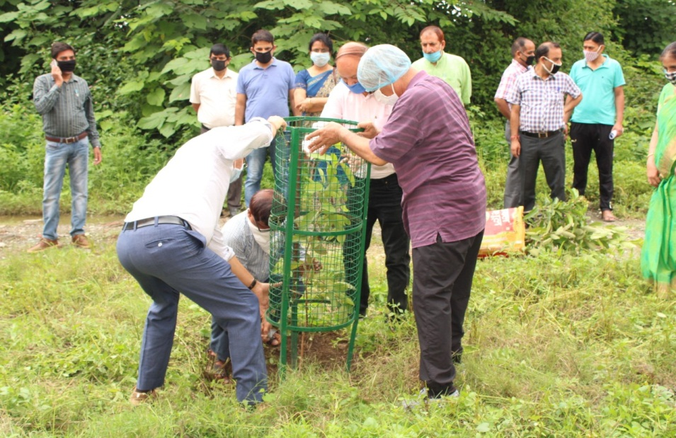
Good Practices: विदाई समारोह, सम्मान समरोह , पौधरोपण इत्यादि

Slide 25
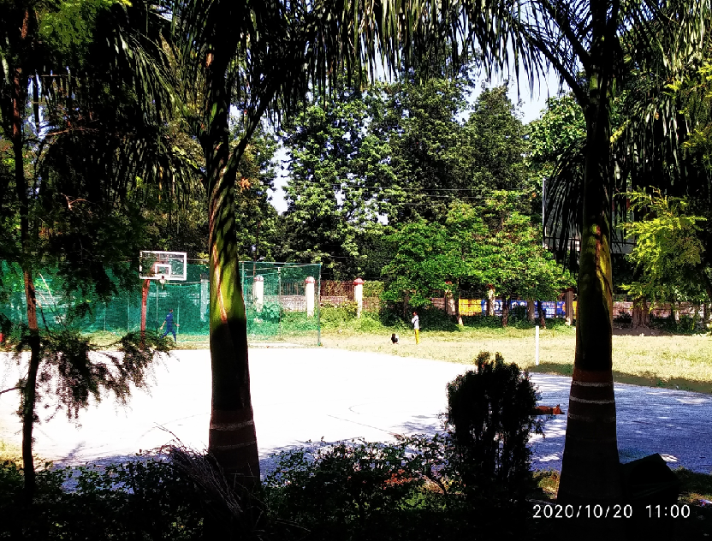
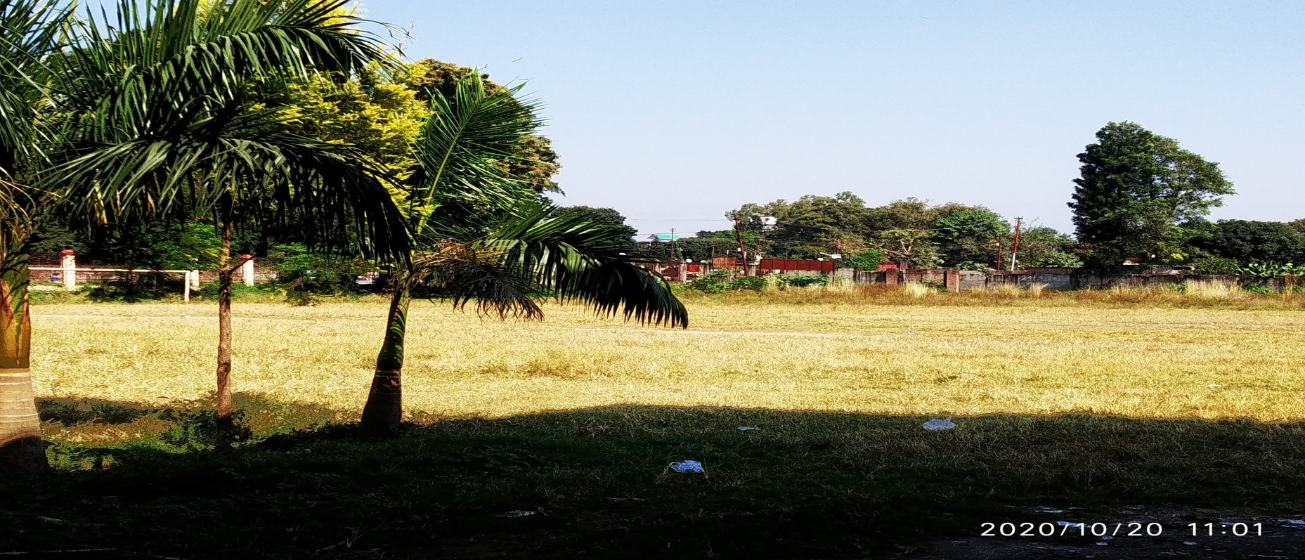
Cricket practice Pitch, basketball court
and
Football ground of College

Slide 26
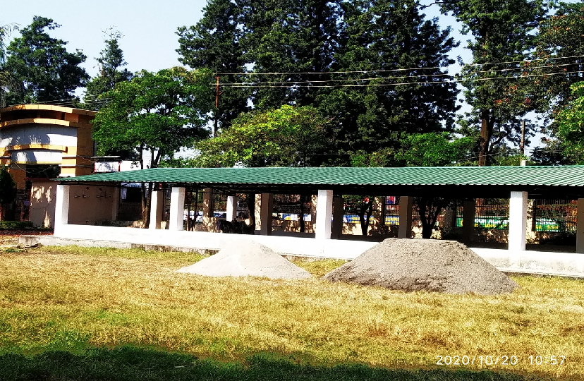
Student’s Parking (RUSA)

Slide 27
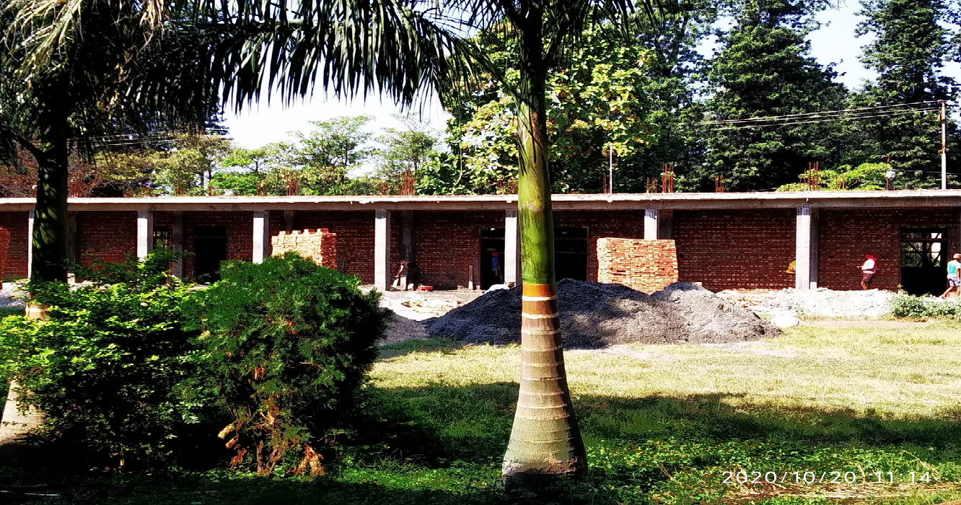
Smart Classrooms (RUSA)

Slide 28
Keep in mind and try to follow
Always keep your college ID-card.
Be in Uniform
Keep sanitizer
Be in mask and do maintain physical distance
(Note: we belongs to rich civilization and it is known for socialisation i.e. relation, family, kinship etc.
So, do not keep social distance maintain physical distance of 2 feet)
About Regular class will provide you information soon
Link you can use:
https://www.youtube.com/channel/UCeBfpZvsxbnr_qMWu4gT2XQ?view_as=subscriber
wharsapp no 7017413688 (BA-1 sem 2020-23) to fram whatsaap gruop
साफ रहो स्वस्थ रहो,
(केवल स्वंय को नहीं अपने आस –पास को भी साफ रखो.)
+
जागरूक बनो , जिमेदार बनो

Slide 29
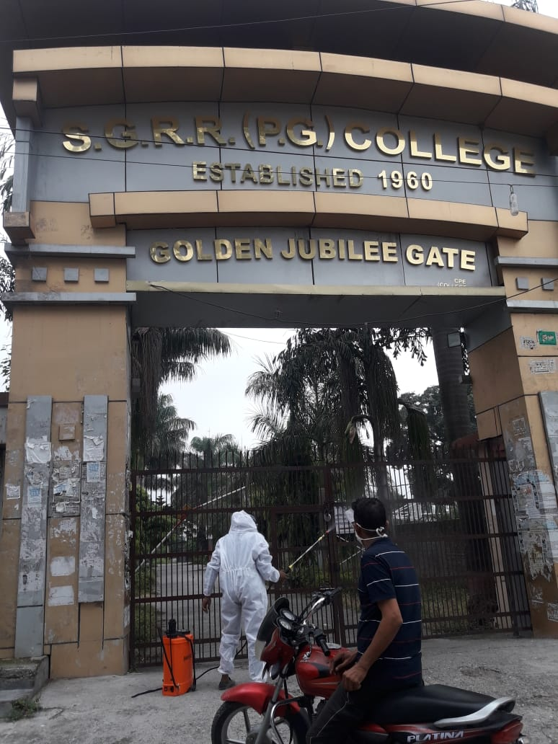
Thank you very much
And
my best wishes

