Slide 1

Rover and Ranger Units
SGRR(PG)College,Dehradun
Registered on 20/10/2009
Registered unit : 02
Ranger : 01(Shivalik ranger crew )
Rover : 01 (Himalyan rover crew)
In charge
1.Dr M.S Gusain (Department of History)
(trained rover scout leader, Completed basic course and advances course)
2. Dr Anita Manori, Department of Physics
3.Helping Assistant: Mr Lakhpat Butola

Slide 2
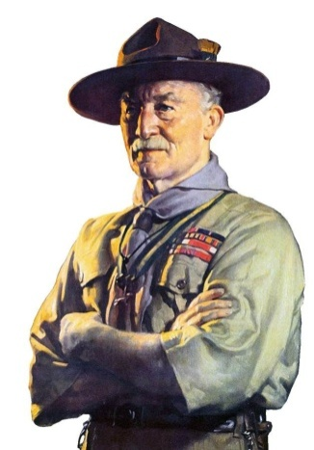
About Scouting
Founder of Scouting: Baden Powell (1907)
(Full name: Robert Stephenson Smyth Baden-Powell)
Born:
22 February 1857, Paddington,London, United Kingdom
Died: 8 January 1941, Nyeri, Kenya
The purpose of Scouting is to encourage the physical, intellectual, social, emotional and spiritual development of young people so that they take a constructive place in society as responsible citizens, and as members of their local, national and international communities.

Slide 3
VISION of Rover and Ranger
Rover/Ranger is the higher wing of Bharat Scout and guide.
This is a Internationl youth movement .
Rovers/Rangers will get varied opportunities to develop individually and also develop in group.
Here you will also get encouragement and will know “Yourself”.
You will discover really who you are as a person.
This will help you to lead a happy life.
Its programmes are very helpful in disaster management. The movement has power to change the attitude of our youth and ability to make them able to handle every kind of situations.

Slide 4
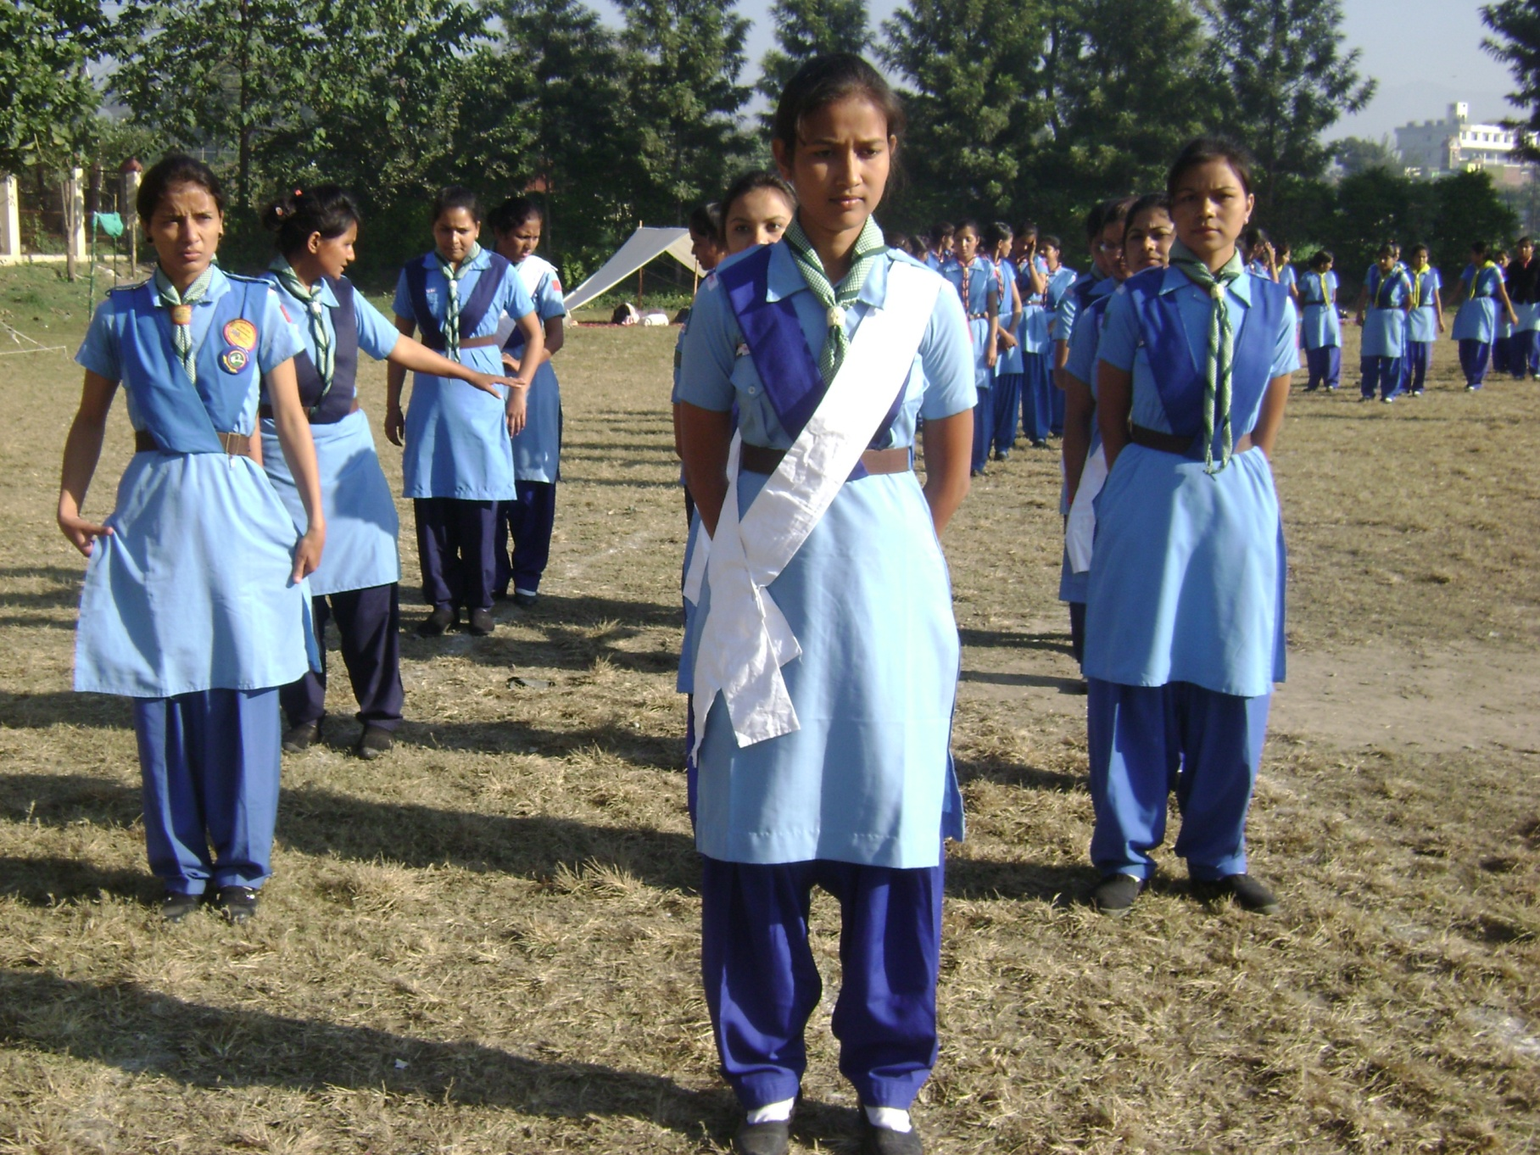
Dress Rangers

Slide 5
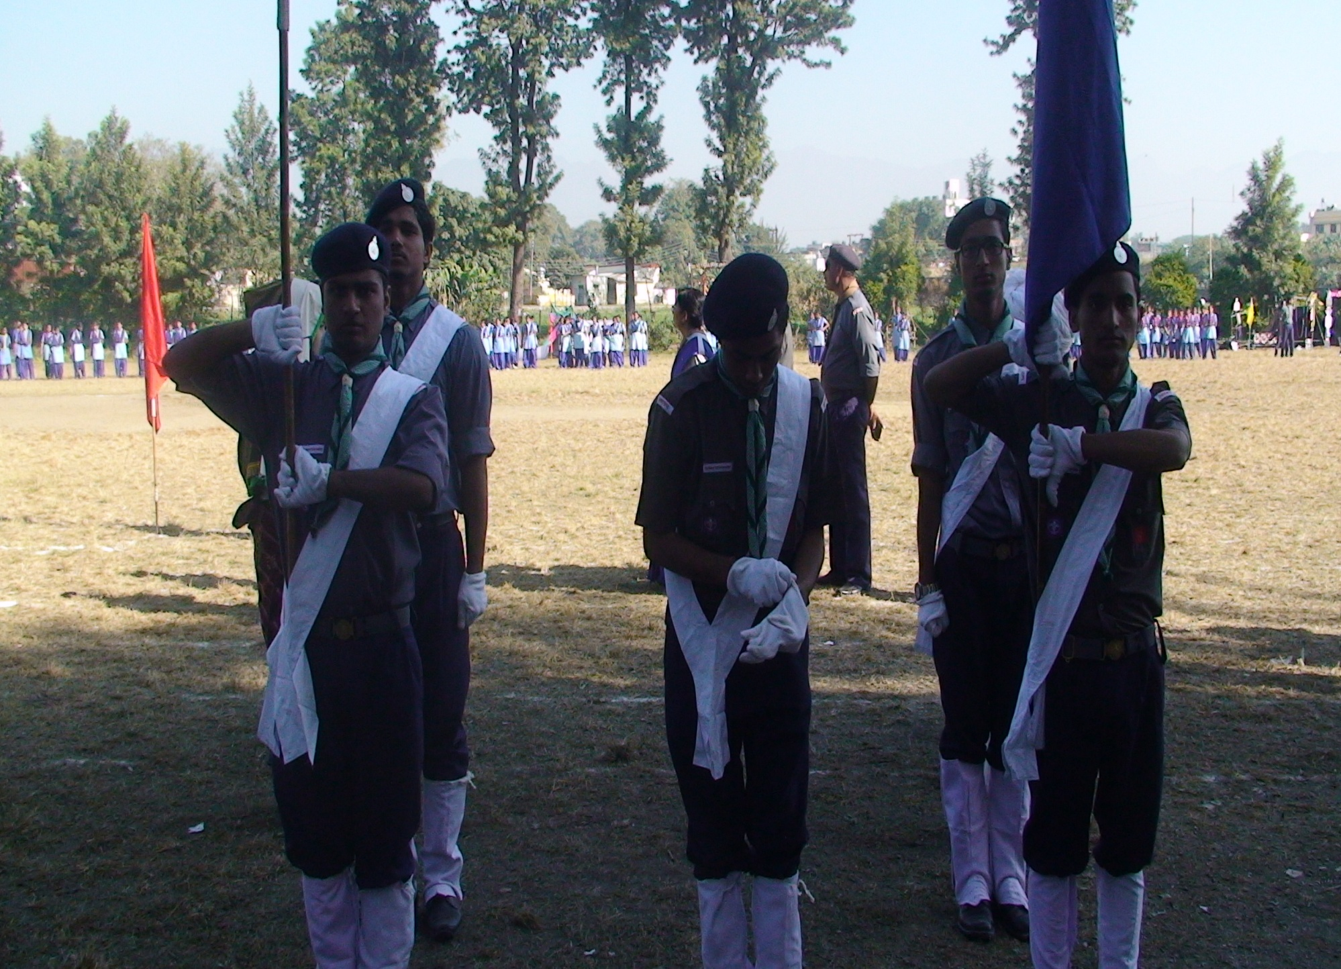
Dress Rovers

Slide 6
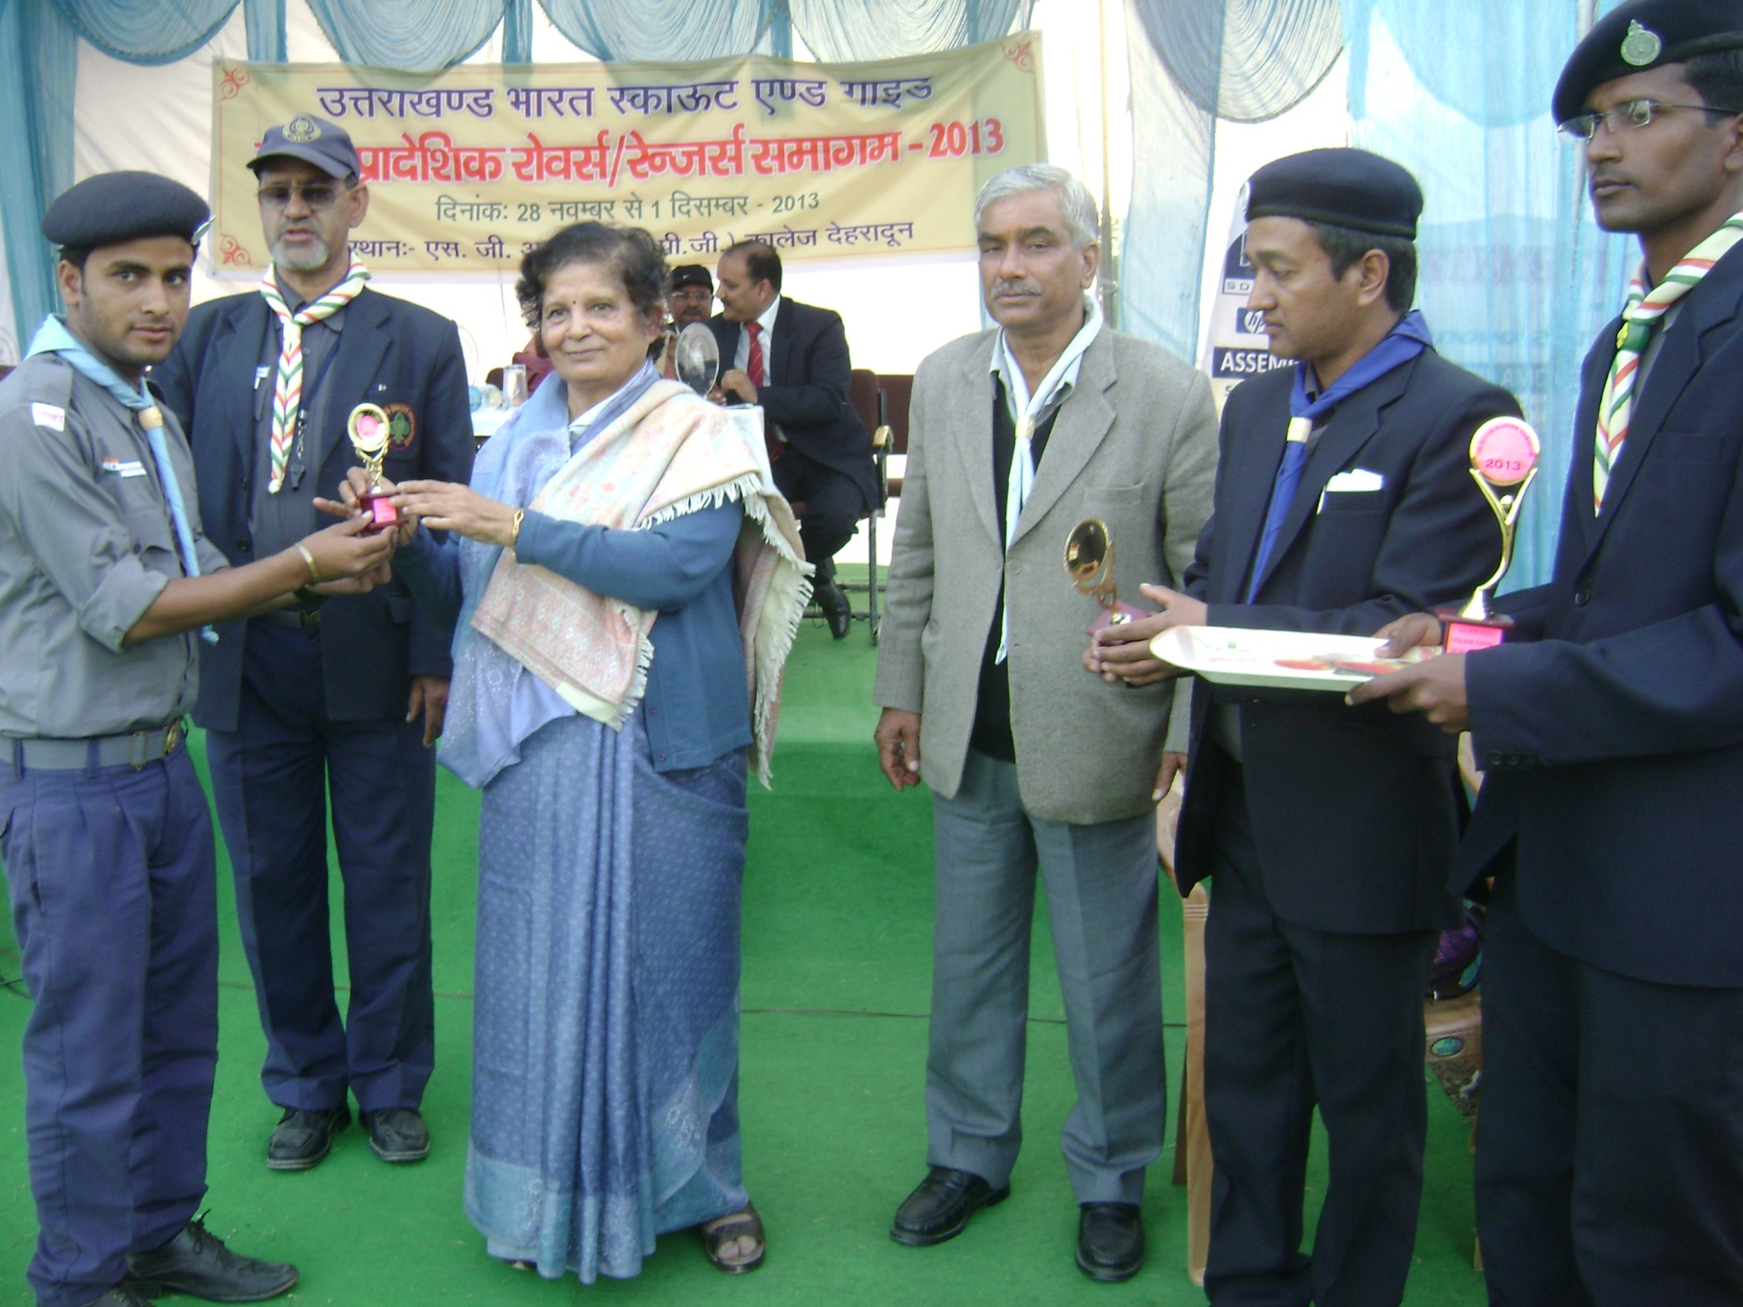

Slide 7
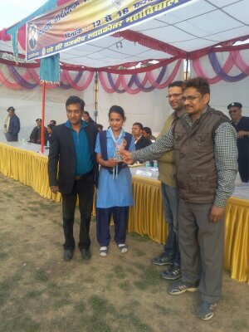
Samagama at Kashipur

Slide 8
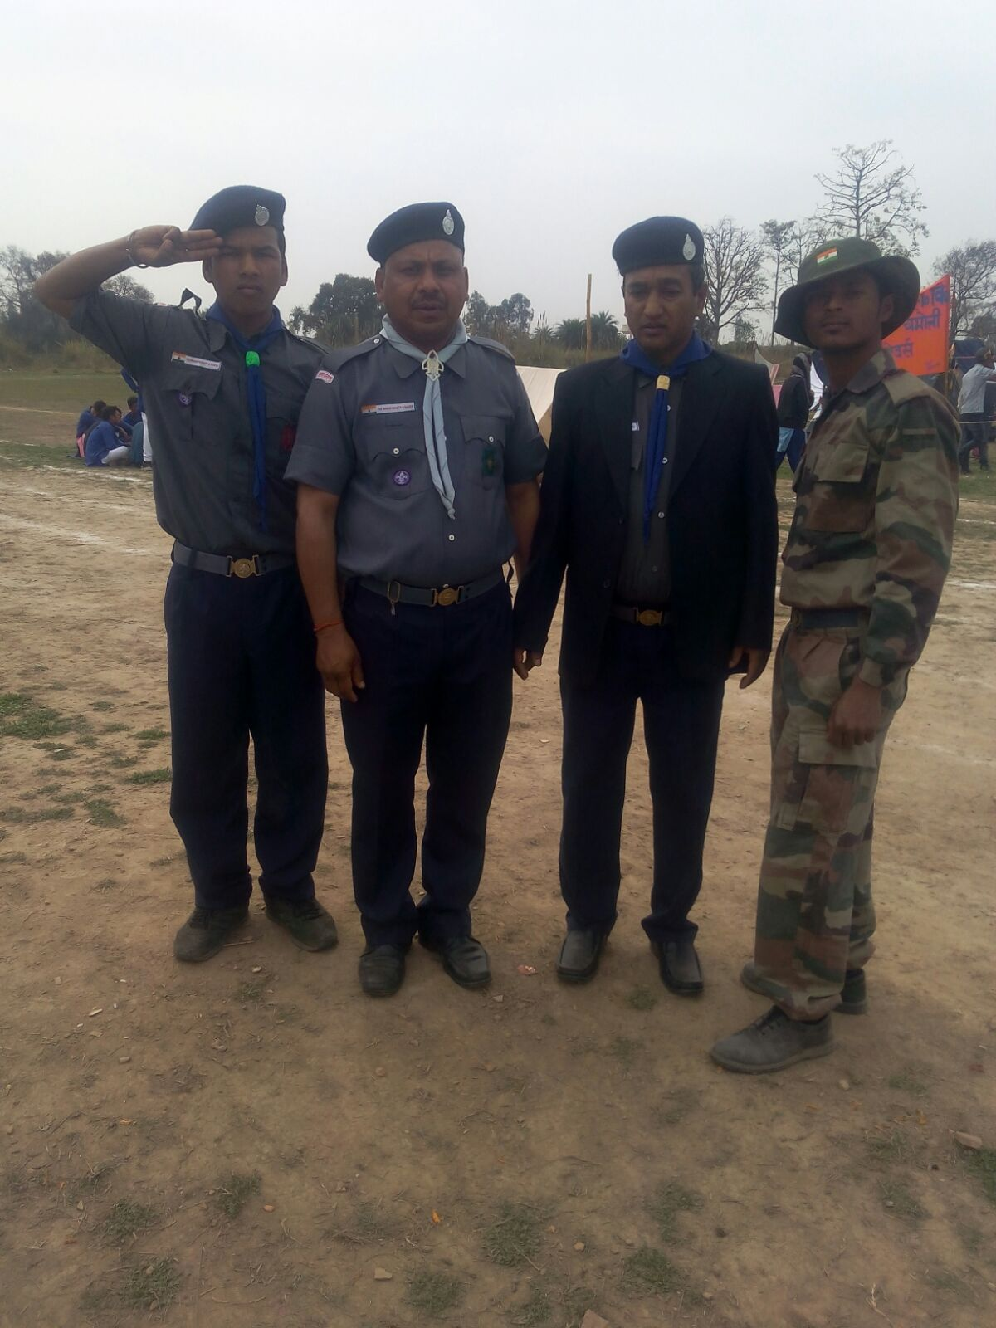
Salute of Scouting

Slide 9
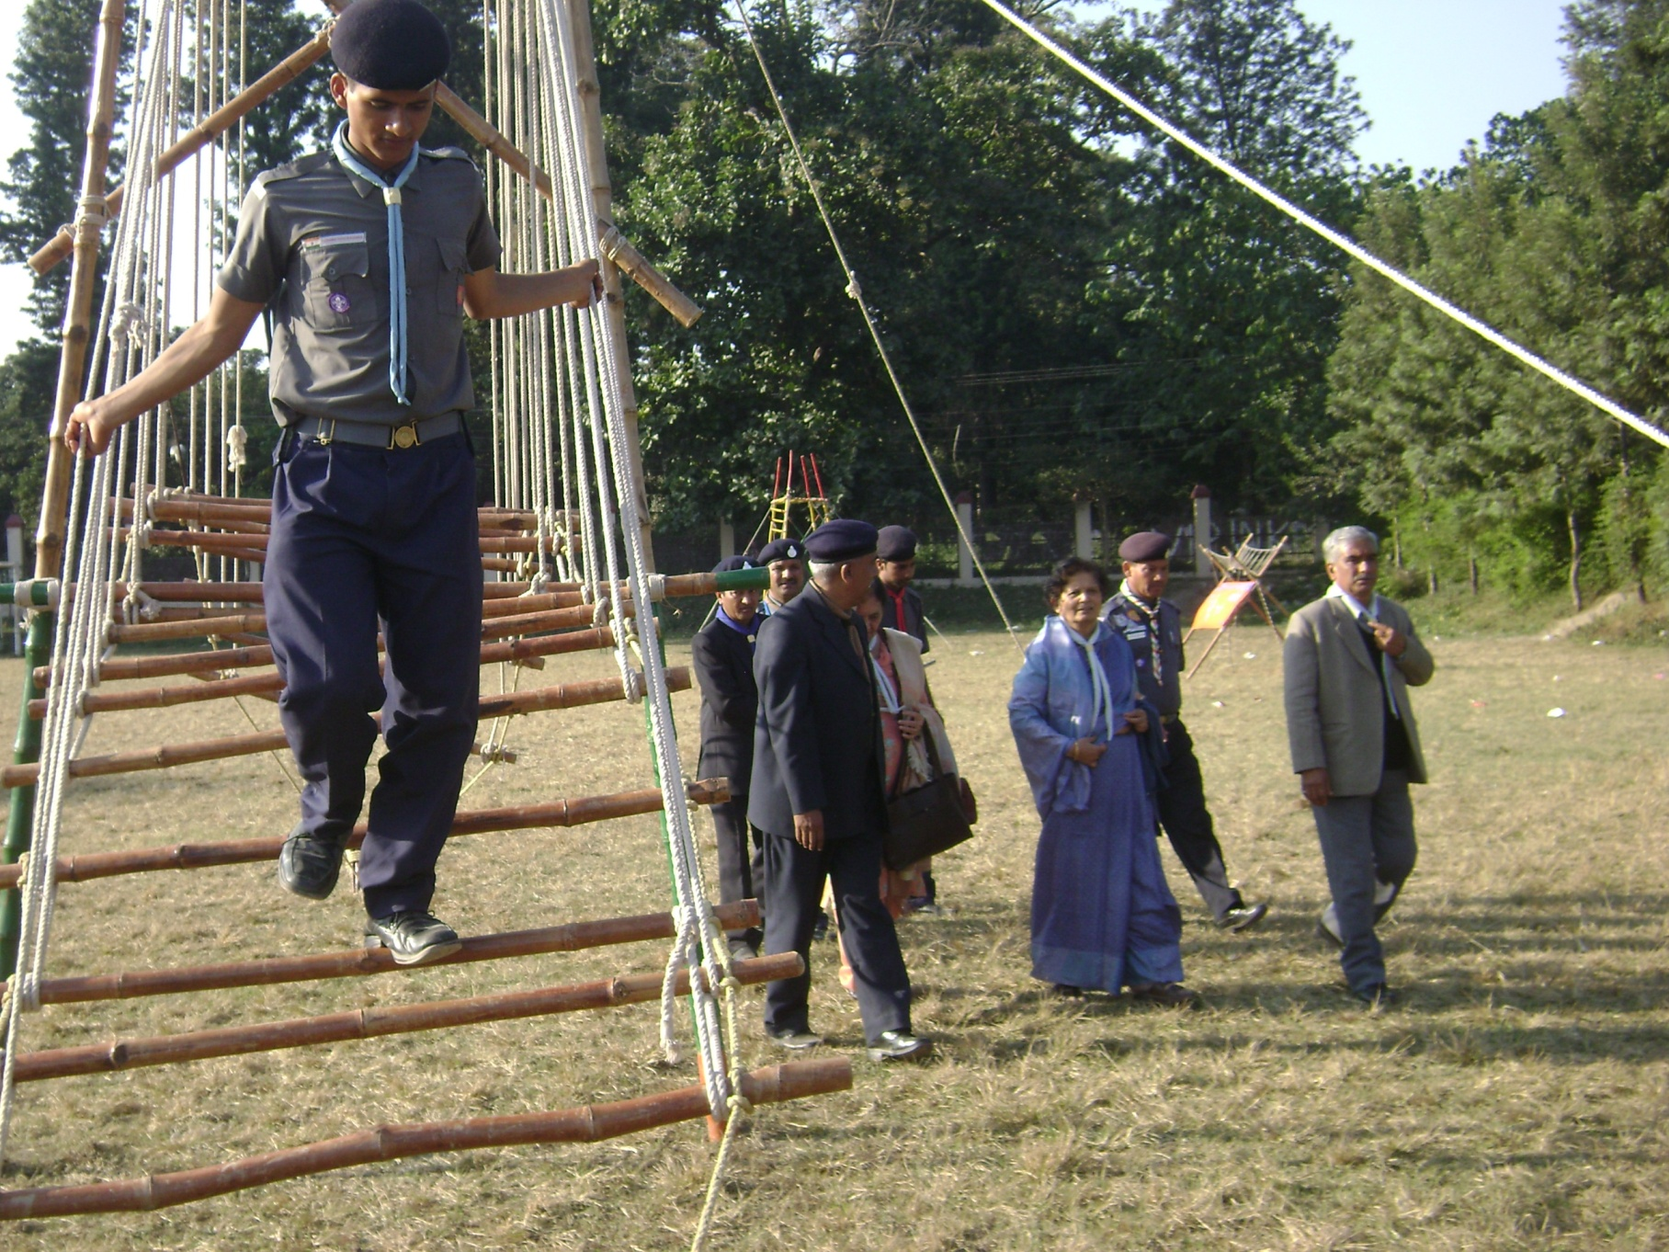

Slide 10

Opportunities
National Adventure Programmmes through out year
International camps
Mountaineering camps
Mapping camps
State level Adventure camp
Provincial Samagama every year.

Slide 11
opportunities
2% job in Indian Railways in Group C and D
President award
Vice President award
Governor Award.
Makes you ready to handle difficult situations.

Slide 12
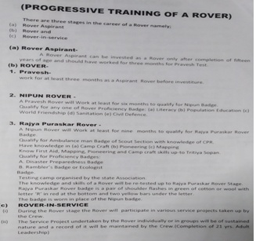
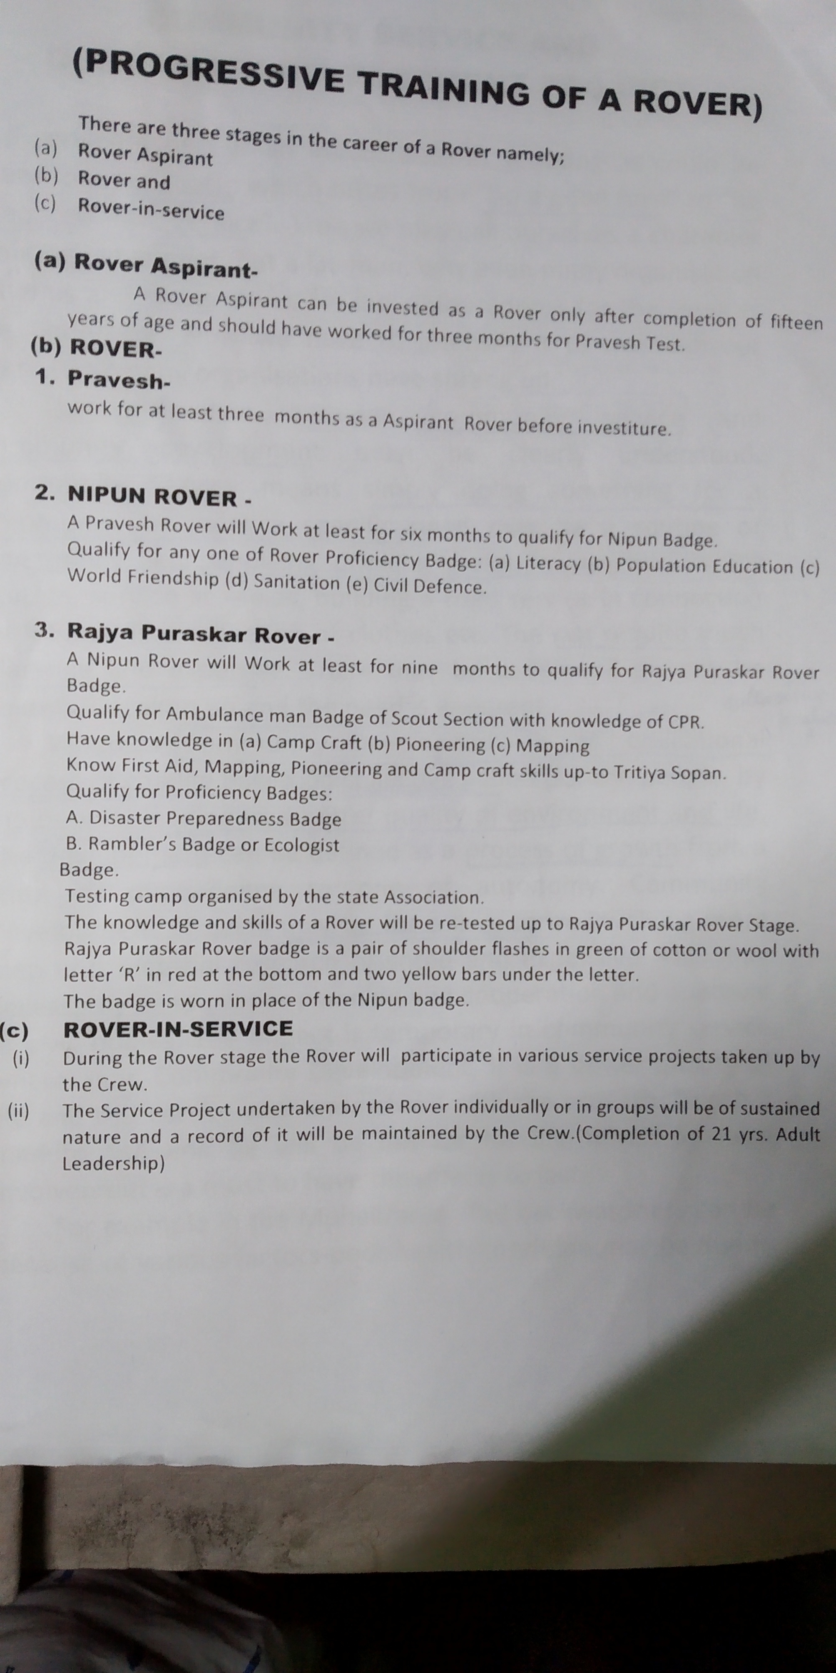

Slide 13
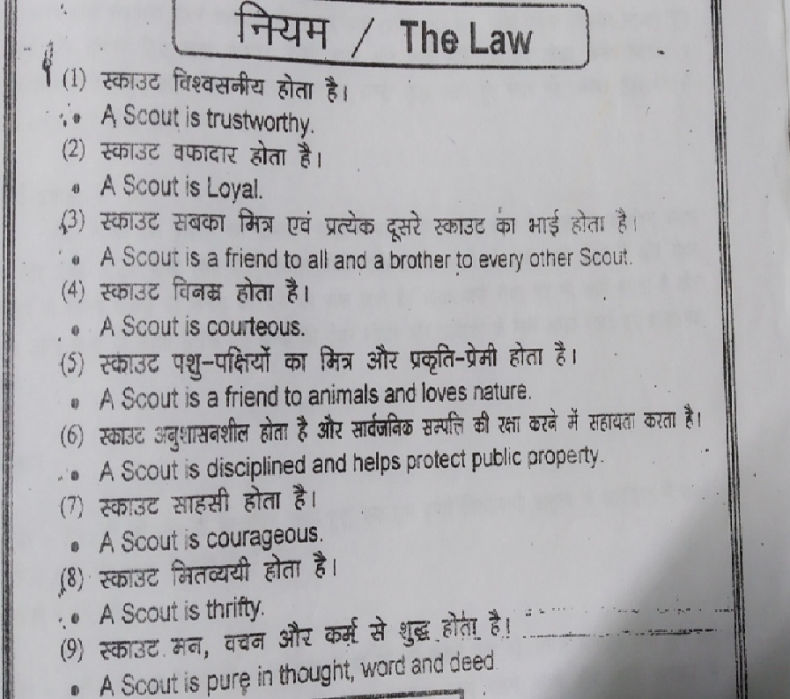

Slide 14
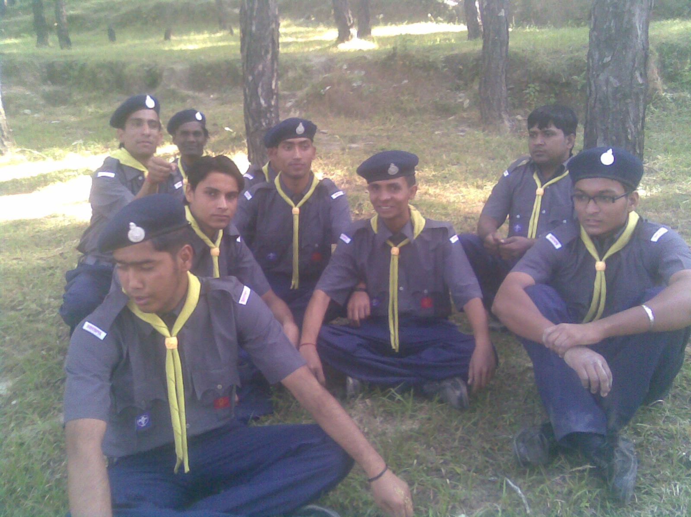
rovers
This program is designed to produce a true human ,
hence all those who really want too be true human……………………
Welcome to our unit
OUR MOTIVE
lsok&Hkko
Thanks

